Slide 1
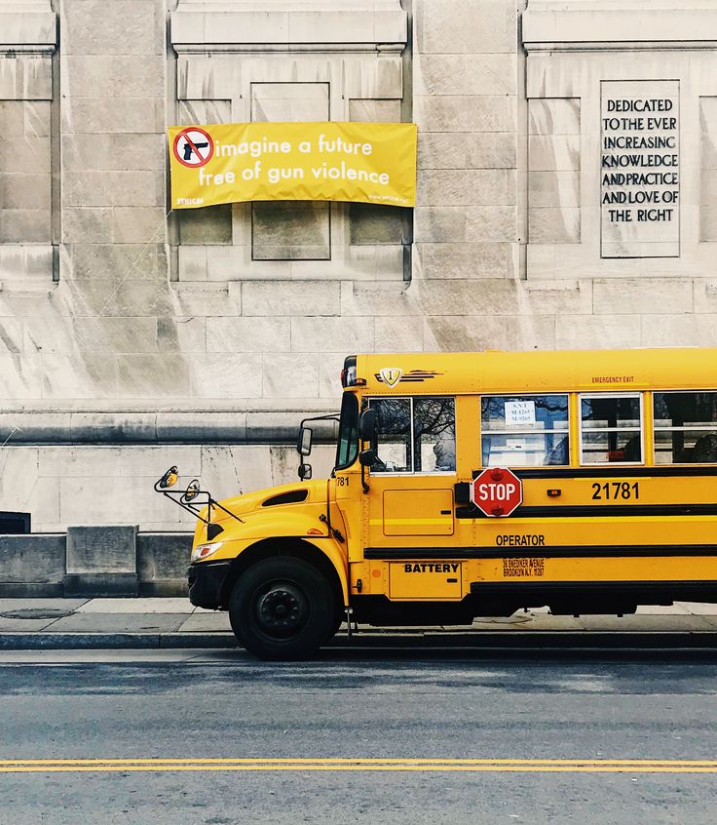
BUS TICKET RESERVATION SYSTEM
Group No:-10
Percy Dutta(20070123061)
Mahum Fareed Khan(20070123117)

Slide 2
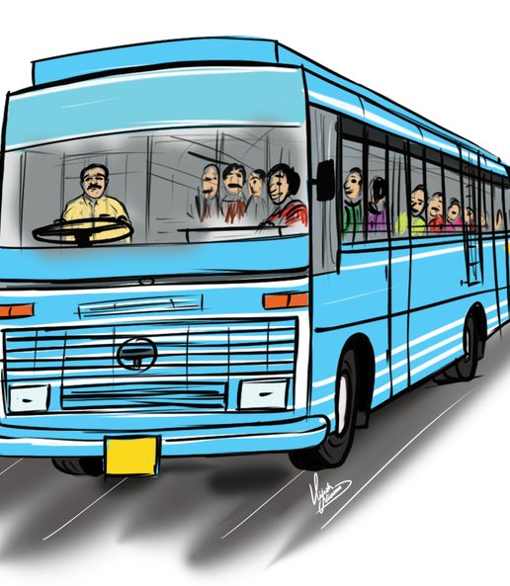
Problem Statement
To develop a bus ticket reservation system that allows passengers to book and manage bus tickets for various routes and schedules.

Slide 3
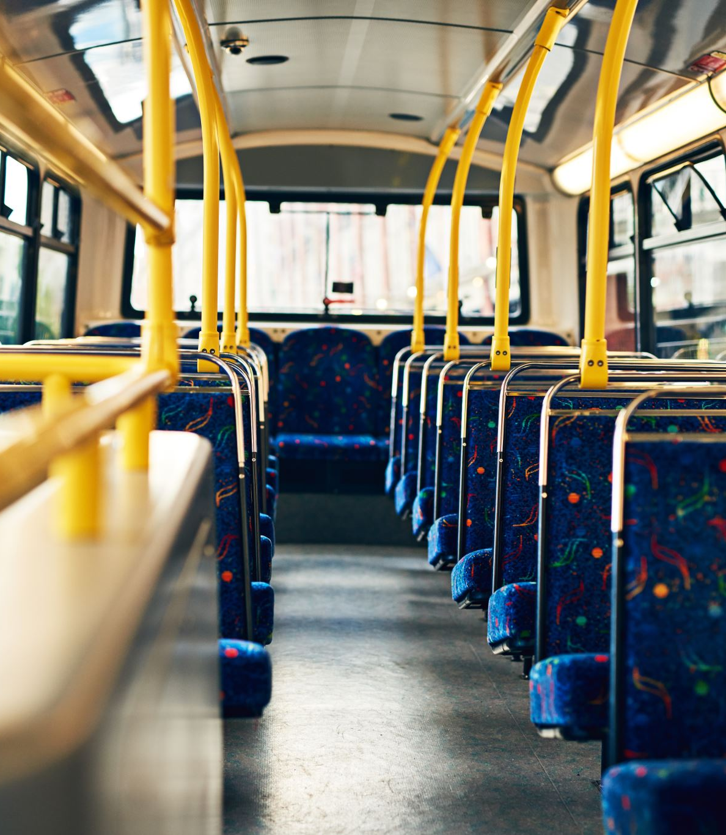
Specifications
The system will provide a user-friendly interface for both users and administrators.
Passengers will be able to search for available bus routes, view schedules, check buses from different agencies, and book tickets.
Administrators will be to manage bus routes, schedules, and passenger bookings.
Administrators will be able to see the booking status for every bus.

Slide 4
Functional Requirements
1. User Registration
Passengers can create accounts with their personal information.
Administrators can create accounts with special privileges.
2. Route Management
Administrators can add, edit, or delete bus routes.
Each route has a name, origin, destination, distance, and price.
3. Schedule Management
Administrators can define schedules for each route, including departure times and days of operation.
Passengers can view available schedules.

Slide 5
Functional Requirements
4. Ticket Bookings
Passengers can search for routes and schedules.
Passengers can select a route and schedule, choose the number of tickets, and make a booking.
Booking confirmation with an e-ticket is sent to the passenger.
5. Route Management
Passengers can view their booked tickets and cancel them if needed.
Administrators can view and manage passenger bookings.
6. Payment Processing
Securely process payments using various payment methods (e.g., credit cards, online wallets).
Generate and send electronic tickets upon successful payment.

Slide 6

Entities and Relationships
User/Passengers:- p_id, p_phone, p_name
Buses:- b_id, b_name, b_agency, Total_seats.
Routes:- b_id, R_id, origin, destination, distance, price.
schedules:- b_id, R_id, Departure_time, Arrival_time.
Booking:- p_id, b_id, booked_seats, available_seats.
payment:- p_id, payment_status, total_price.

Slide 7
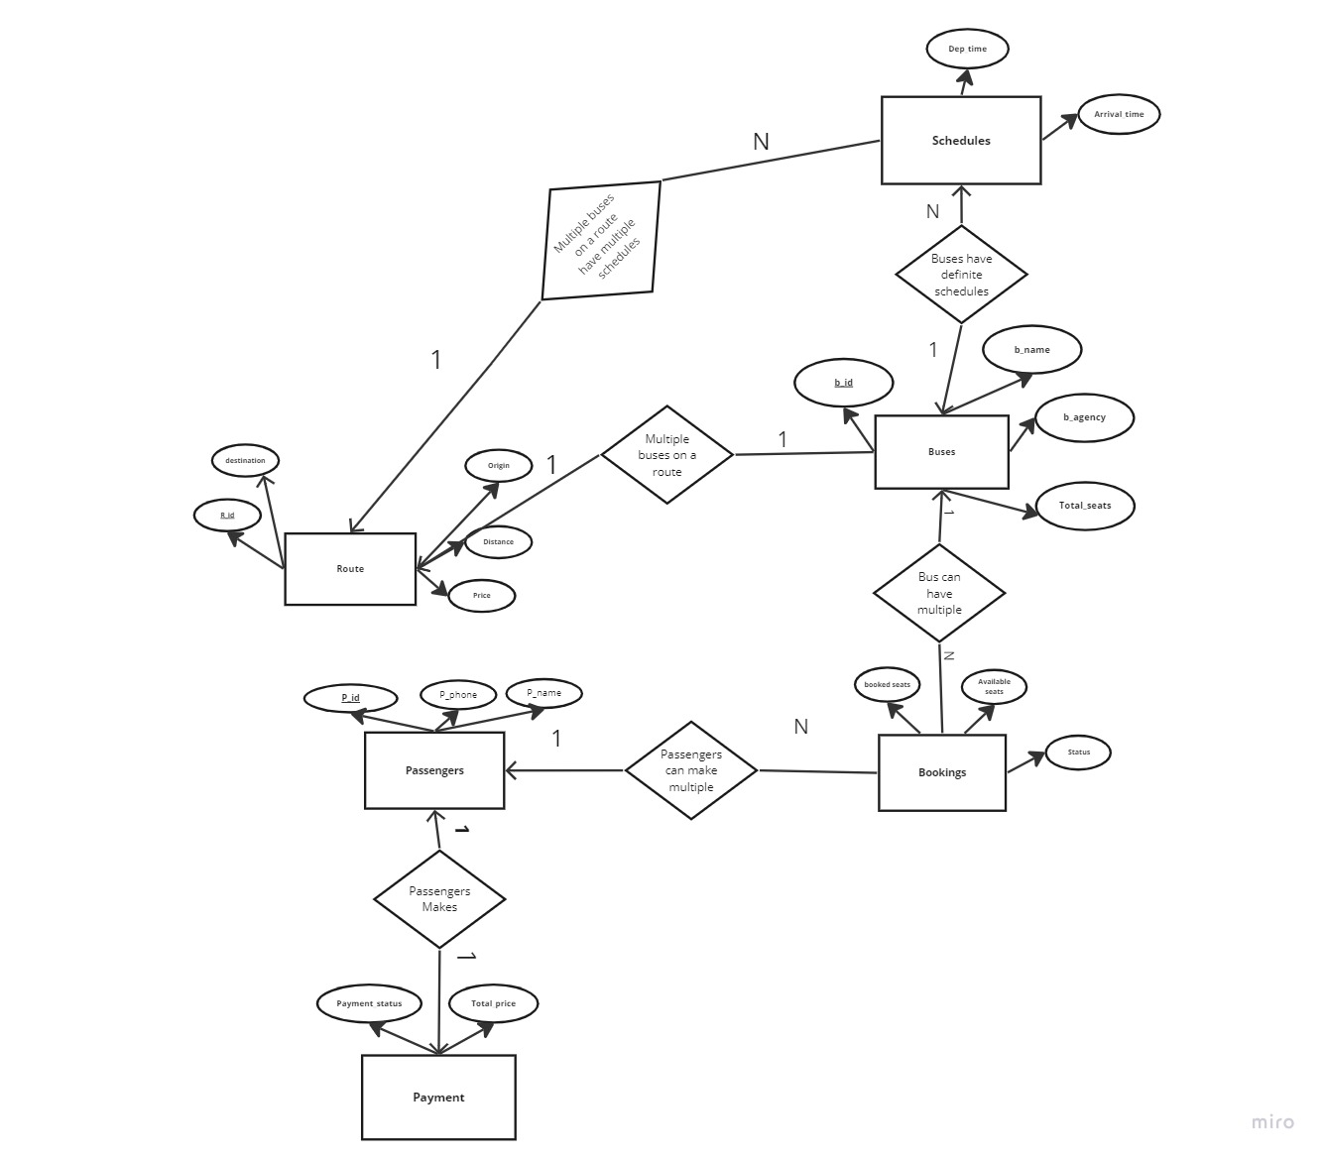
ER-Diagram

Slide 8

Thank you

